Slide 1



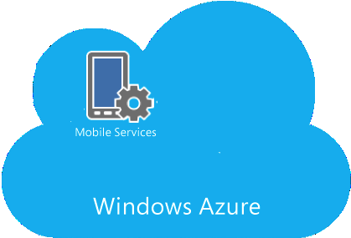

Talkback related info:
- Users
- Groups
- Relationship
- Configuration Info
Google Could Service
Push Messages & Alerts
SQL
Server
(Un)Register Device
(prepare my tablet/erase & clean)
All Users:
- Messages
- Alerts
- Archives
- User Reg. Info
Notification Service
Get Contacts, Groups
(prepare my tablet)
Send Messages & Alerts
SQLite
Talkback
Wide Angle
Talkback (app)
Add contacts, create group, etc.
Send Message
TalkBack
Services
SQL
Azure
Current User's:
- Contacts
- Groups
- Alerts
- Messages

